Slide 1
Project on
Inductive Representation Learning on Large Graphs
By
Yaswanth BestaVemula Harsha Vardhan Royal Amidela Rahul Boyapati

Slide 2
INTRODUCTION
GraphSAGE is a novel framework aimed at inductive representation learning on large graphs. Traditional methods for node embeddings rely on transductive settings where all nodes must be present during the training phase. This limitation restricts the application of such models to dynamic graphs where new nodes are continuously added. GraphSAGE, however, utilizes node feature information (such as text attributes) to efficiently generate embeddings for previously unseen nodes. By learning a function that aggregates features from a node’s local neighborhood, GraphSAGE can generate embeddings dynamically, adapting to new nodes without the need for retraining.

Slide 3
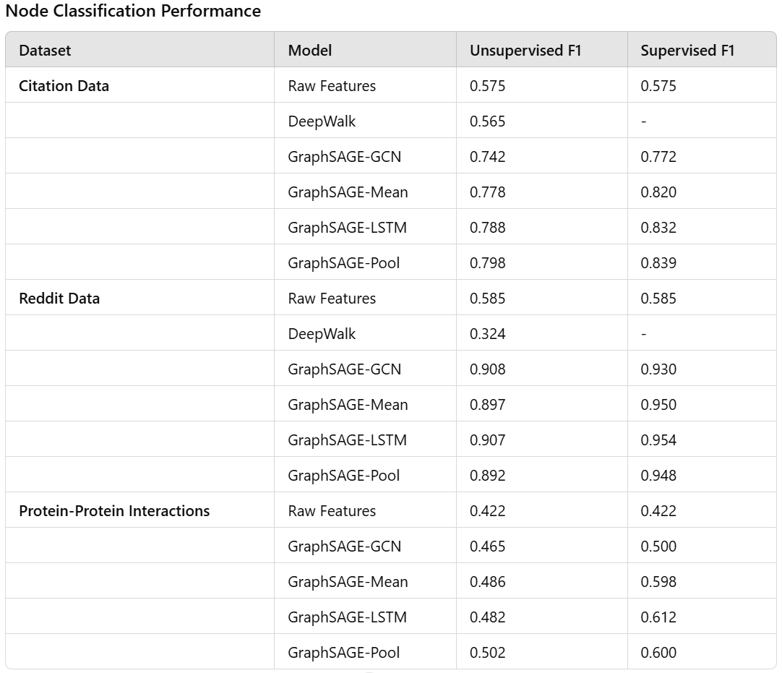
RESULTS
GraphSAGE was evaluated on several benchmarks for inductive node classification tasks, demonstrating significant performance improvements over traditional methods. Below are the summarized results presented in tabular format for clearer comparison:

Slide 4
Overview:
GraphSAGE utilizes an end-to-end training process that learns to aggregate and transform feature information from local neighborhoods into node embeddings.
Loss Functions:
Unsupervised Learning:
The loss function encourages nearby nodes to have similar embeddings while pushing apart embeddings of nodes that are not connected.Specifically, it uses a pairwise loss with negative sampling.
Supervised Learning:
Employs a cross-entropy loss tailored to specific tasks, such as node classification or link prediction, directly optimizing for task performance.
Training the Model
Optimization Strategy:
Uses stochastic gradient descent (SGD) to optimize the model parameters.
Learning rate and other hyperparameters are tuned based on validation set performance.
Regularization and Dropout:
Incorporates techniques such as L2 regularization and dropout to prevent overfitting and improve model generalization.

Slide 5
Parameter Updates:
Model parameters are updated iteratively based on mini-batches of graph data to efficiently handle large graphs.
Utilizes the Adam optimizer for better convergence in training deep models.
Aggregation Functions:
Trainable functions that combine feature information from a node’s neighbors.
Key to adapting the model to different graph structures and feature distributions.
Training the Model
Training Epochs and Batches:
Multiple epochs over the data ensure thorough learning.
Batches are sampled via a neighborhood sampling strategy to maintain manageable computational complexity.
Evaluation and Validation:
Continuous evaluation on a held-out validation set to monitor training progress and avoid overfitting.
Adjustments to the learning rate and other hyperparameters based on validation performance.

Slide 6
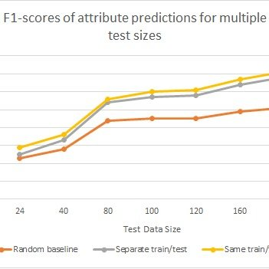
Results:
Performance on Citation Network Dataset
Bar-chart showing F1-scores for the baseline and our model on actual test data using separate training and test generation images, and using same images for training and test data generation

Slide 7
Project Set-Up
Installation Requirements
Required software: TensorFlow, numpy, scipy, sklearn, networkx (<=1.11)
Installation command: ‘pip install -r requirements.txt’
Setting Up with Docker
Docker installation
Building and running the Docker image
Commands for running with Docker and GPU support
The process to setup docker is mentioned in the readme file

Slide 8
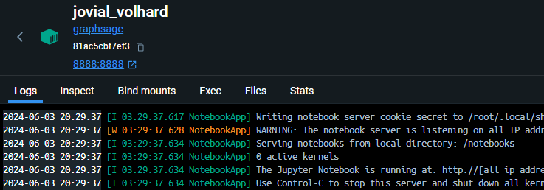
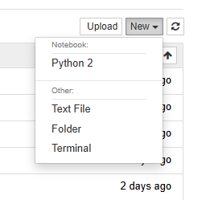
How to do?
Open the localhost from the docker
Open new terminal in Jupiter

Slide 9
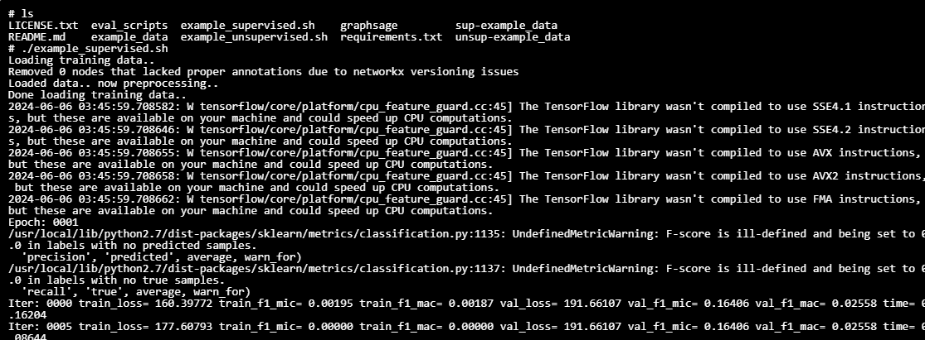
Run the commands to run the python files
Command to run supervised data:
./example_supervised.sh

Slide 10
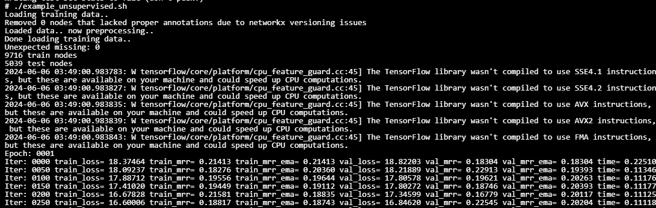
Run the commands to run the python files
Command to run un-supervised data:
./example_unsupervised.sh

Slide 11
Conclusion
GraphSAGE, an inductive framework leveraging node features, efficiently generates embeddings for unseen nodes in large, evolving graphs. It outperforms state-of-the-art baselines in accuracy and scalability by sampling node neighborhoods. Our theoretical and empirical analyses highlight the framework's ability to learn local graph structures effectively, particularly with pooling and LSTM aggregators. Future work includes exploring non-uniform neighborhood sampling and extending GraphSAGE to directed or multi-modal graphs.

Slide 12
THANK YOU

